Slide 1



Slide 2


S3 Encryption
Create S3 bucket
Review encryption options
Review the server-side encryption options available in s3
Enforce encryption
(Enforce server-side encryption using bucket policy)
Test the policy
(Try uploading an un-encryption file to see if policy is working)

Slide 3
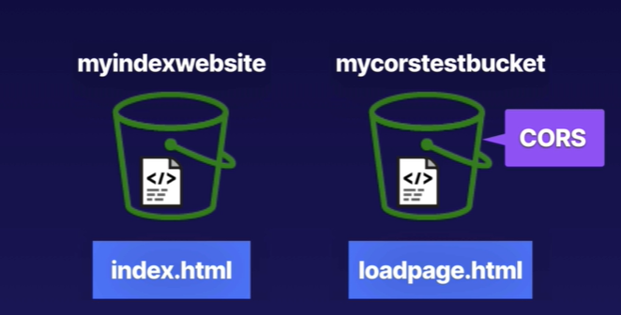
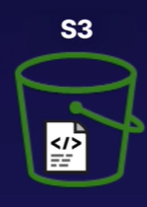


Cross-origin resource sharing (CORS)

Slide 4





CloudFront Distribution Architecture
S3
CloudFront Distribution
EC2
ELB
Own Server

Slide 5
CloudFront
Create S3 bucket – far away
Access an image from the S3 bucket.
Create a CloudFront distribution
Prevent direct access to S3 (allow access via CloudFront only)
Access the image via CloudFront
Delete CloudFront

Slide 6
S3 Life Cycle
Automates moving your objects between the different storage tiers.
Can be used in conjunction with versioning
Can be applied to current versions and previous version

Slide 7
Thank you

